Slide 1
what are Ethics? lesson 3
2012

Slide 2
What Are Ethics?
Ethics is a branch of philosophy
Ethics is the systematic analysis of behavioural choices that individuals or societies face.
Ethics is the study of right or wrong, obligations and rights, justice and social and political ideals.

Slide 3
Need for Ethics
Humans face choices in daily life
Choices provide alternative courses of actions that lead to different consequences.
Ethics are a way to rationally reason our choices.

Slide 4
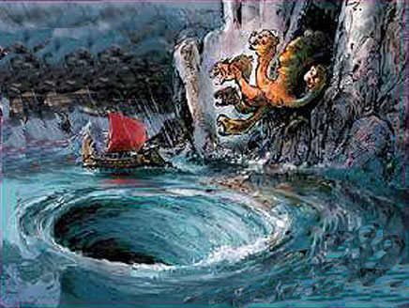
Need for Ethical Reasoning?
It is a guide for rational decisions
Avoids Moral Absolutism: morals are absolute, unchangeable and always true. They NEVER change according to circumstances.
Avoids Moral Relativism: Morals are relative to individuals and so completely subjective. Therefore no one guideline is adequate for everyone.
Scylla of Absolutism
Charybdis of Relativism

Slide 5
Engineering Ethics
It is the analysis of decisions, choices and policies that are morally desirable in engineering practice and research
Purpose:
Moral Awareness: awareness of value conflicts that underlie choices.
Moral Autonomy: Ability to think critically and independently about moral issues.
Moral Imagination: Ability to discern alternative solutions to moral dilemmas.
Moral Communication: ability to communicate ethical issues in a precise and reasonable manner.

Slide 6
Ethics vs Morals
Ethics
Ethics is systematic analysis of human behaviour.
Frameworks are not specific to cultural or geographic context.
Ethics are impersonal
Ethics require rational examination.
Morals
Morals are customary norms of behaviour
Vary with time and geography.
Morals are personal
Morals transmitted through socialization.

Slide 7
Ethics is NOT Personal Opinion!
Ethics is an understanding of the philosophical basis for making moral choices.
Ethics is an objective system of making choices
Objectivity of ethical analysis is qualified by circumstances.
Ex: Do you pardon someone if they kill? If it is in self-defence?

Slide 8
Morals ARE Personal Opinion!
It is a classification of right or wrong acts.
Based on cultural, religious or customary mores.
Can differ from place, community, region & country.
Ex: Not looking at another person’s face is considered respectful in some places or shifty in others.

Slide 9
Law
Laws and Regulations are established by competent authorities in a society
Laws govern what is allowed, required or forbidden
Laws are often based on customs, and morals.

Slide 10
How is Professional Morality created?
External Influences
Internal Influences
Governance by an Outside Authority
Law
Engineering Ethics
Morals
Self-Governance
Ethics
Values
Engineering Ethics
Code of Ethics

Slide 11
Code of Ethics
External Governance
Self-Governance
Code of Ethics

Slide 12
OIQ’s Code of Ethics for Engineers
National Assembly required engineers to adopt a code that would establish rules of conduct for professional practice.
The Code of Ethics is a mandatory regulation for engineers.
Engineer’s duties and obligations towards
Public
Clients (including employees)
Profession

